Slide 1
Linked List
Sakkaravarthi

Slide 5
tail

Slide 6
Illustration of a linked list in memory:
node
pointer to a
next node
pointer to
an element

Slide 7
node
pointer to a
next node
pointer to
an element

Slide 8
node
pointer to a
next node
pointer to
an element

Slide 9
node
pointer to a
next node
pointer to
an element

Slide 11
Singly Linked Lists and Arrays

Slide 12
Applications
Previous and next page in web browser – We can access previous and next url searched in web browser by pressing back and next button since, they are linked as linked list.
Music Player – Songs in music player are linked to previous and next song. you can play songs either from starting or ending of the list.

Slide 13
Class Node
Here is an implementation of nodes in Java:
public class Node {
private Object element;
private Node next;
public Node() {
this( null, null );
}
public Node( Object e, Node n ) {
element = e;
next = n;
}

Slide 14
Object getElement() {
return element
}
Node getNext() {
return next;
}
void setElement( Object newElem ) {
element = newElem;
}
void setNext( Node newNext ) {
next = newNext;
}
}

Slide 15
Linked List Operations

Slide 16
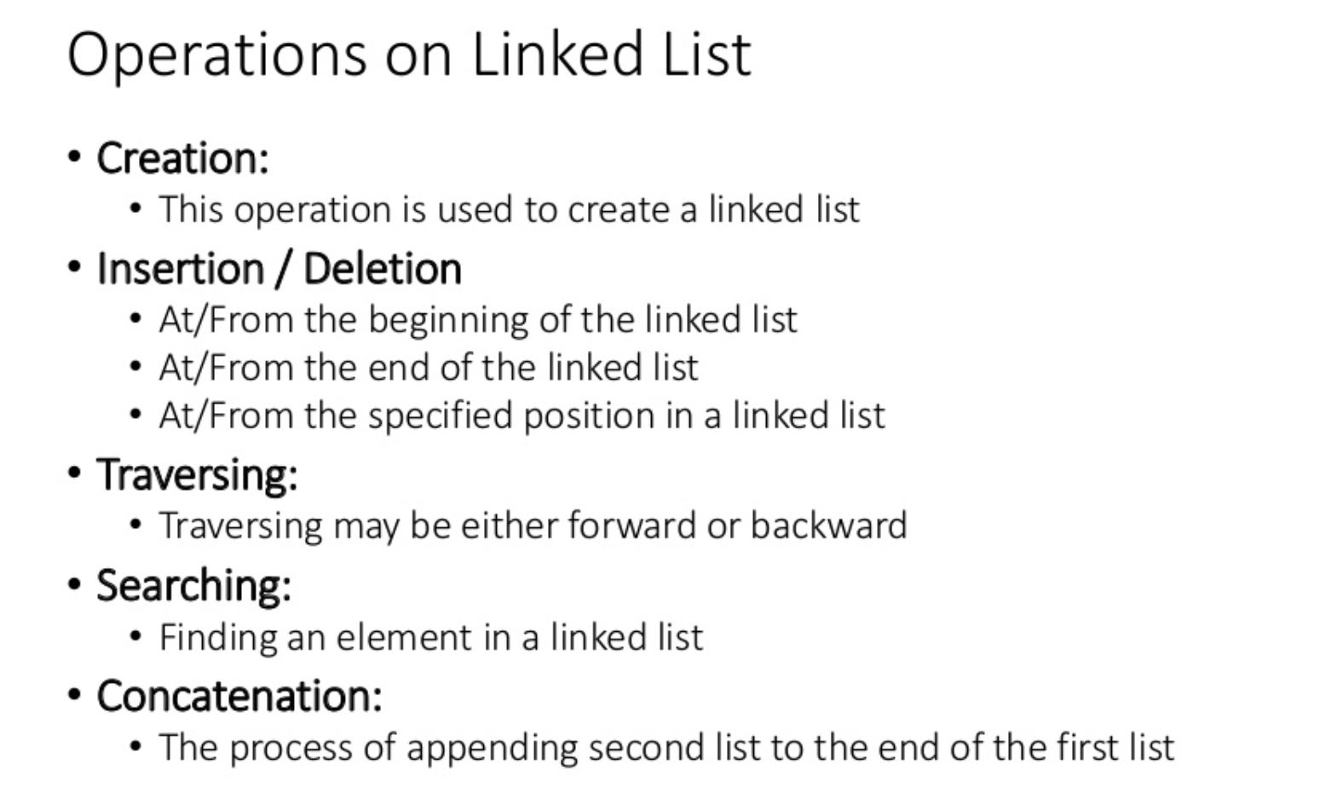

Slide 17
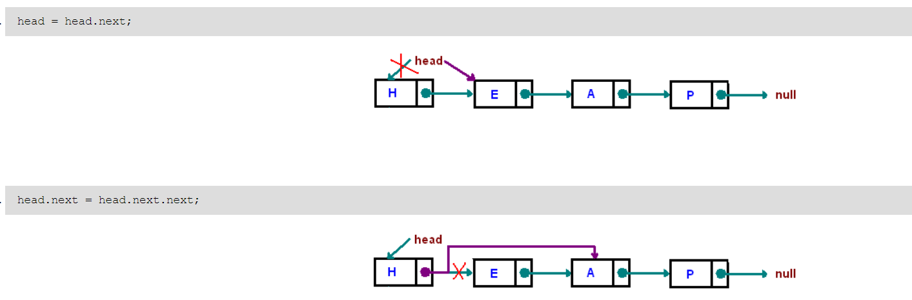
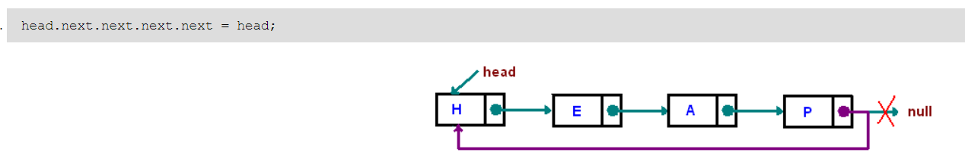
Examples

Slide 18
Insertion Description
Insertion at the top of the list
Insertion at the end of the list
Insertion in the middle of the list

Slide 19
Insertion at the top
Steps:
Create a Node
Set the node data Values
Connect the pointers

Slide 20


Insertion Description
head
48
17
142
//
Follow the previous steps and we get
Step 1
Step 2
Step 3
head
93

Slide 21
Insertion Description
Insertion at the top of the list
Insertion at the end of the list
Insertion in the middle of the list

Slide 22
Insertion at the end
Steps:
Create a Node
Set the node data Values
Connect the pointers

Slide 23



Insertion Description
head
48
17
142
//
Follow the previous steps and we get
Step 1
Step 2
Step 3

Slide 24
Insertion Description
Insertion at the top of the list
Insertion at the end of the list
Insertion in the middle of the list

Slide 25
Insertion in the middle
Steps:
Create a Node
Set the node data Values
Break pointer connection
Re-connect the pointers

Slide 26




Insertion Description
Step 1
Step 2
Step 3
Step 4

Slide 27
Insertion of an Element at the Head

Slide 28
Node x = new Node();
x.setElement = (new String(“Baltimore”));

Slide 29
X -> setNext=head;
head = x;

Slide 30
Deleting an Element at the Head

Slide 31
head = head.getNext();

Slide 33
Insertion of an Element at the Tail

Slide 34
Node x = new Node( );
x.setElement(new String(“Baltimore”));
x.setNext(null);
tail.setNext(x);
tail = x;

Slide 36
How to keep “head” and “tail”?
public class Head_and_Tail {
Node head;
Node tail;
Head_and_Tail(Node x, Node y)
{
head = x;
tail = y;
}
}

Slide 37
Deletion Description
Deleting from the top of the list
Deleting from the end of the list
Deleting from the middle of the list

Slide 38
Deleting from the top
Steps
Break the pointer connection
Re-connect the nodes
Delete the node

Slide 39
Deletion Description
head
6
4
17
42
head
6
4
17
42
head
4
17
42

Slide 40
Deletion Description
Deleting from the top of the list
Deleting from the end of the list
Deleting from the middle of the list

Slide 41
Deleting from the end
Steps
Break the pointer connection
Set previous node pointer to NULL
Delete the node

Slide 42
Deletion Description
head
6
4
17
42
head
6
4
17
42
head
6
4
17

Slide 43
Deletion Description
Deleting from the top of the list
Deleting from the end of the list
Deleting from the middle of the list

Slide 44
Deleting from the Middle
Steps
Set previous Node pointer to next node
Break Node pointer connection
Delete the node

Slide 45
Deletion Description
head
4
17
42
head
4
17
42
head
4
42

Slide 46
Search a Node

Slide 47
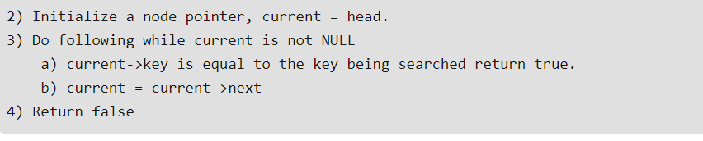
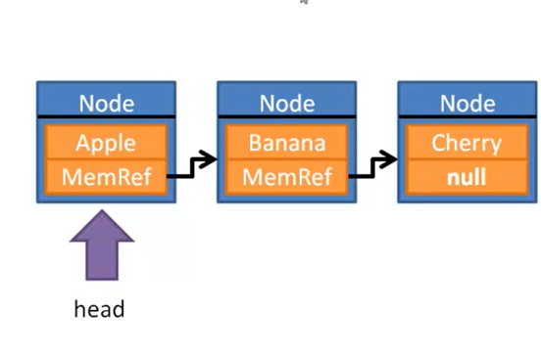
Pseudo Code

Slide 48
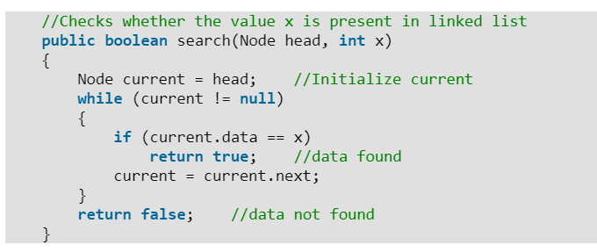
Algorithm

Slide 49
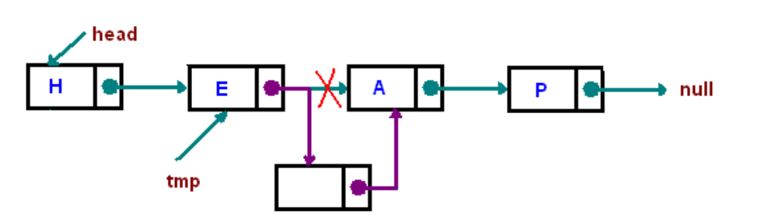
Inserting "after"

Slide 50
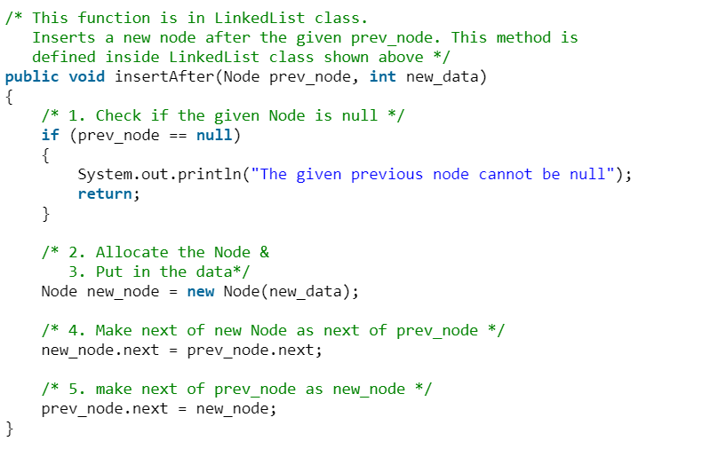

Slide 51
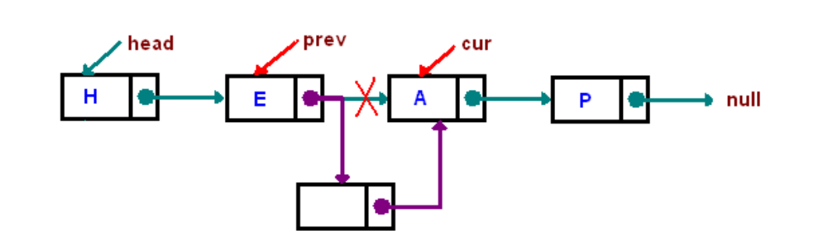
Inserting "before"

Slide 52
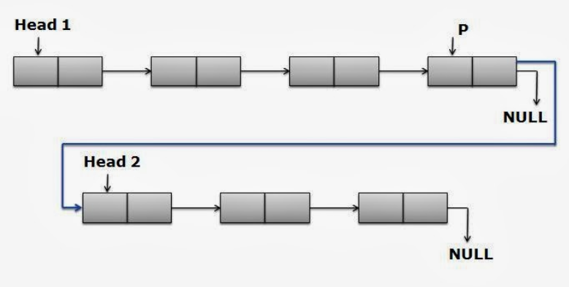
Concatenation of two Linked Lists

Slide 53
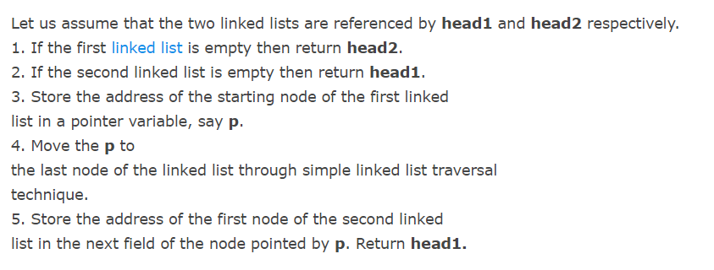
Pseudocode

Slide 54
Alert: Deleting an Element at the Tail

Slide 56
should be removed

